Slide 1


SAP BTP Training
Cloud Foundry Training

Slide 2

DISCLAIMER
The training content and delivery of this presentation is confidential, and cannot be recorded, or copied and distributed to any third party, without the written consent of Anubhav Trainings

Slide 3

LEARNING OBJECTIVES
SAP BTP CAPM Development
SAP HANA Cloud Introduction
Create SAP HANA Backing service in BTP
Connect, Build and Deploy
Cloud MTA
Add UI Module to mta.yaml
App Router Concept
Implementing App router
Deploy and Test

Slide 4
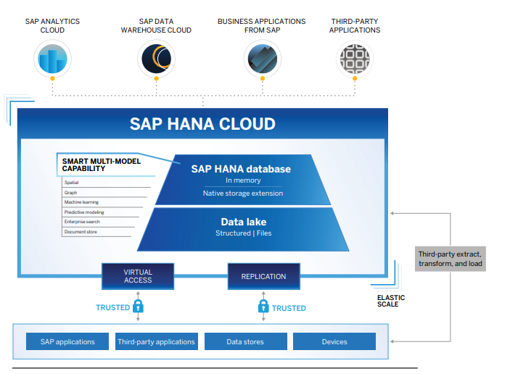
What is SAP HANA Cloud in BTP?
SAP HANA Cloud is a single database as a service (DBaaS) foundation for modern applications and analytics across all enterprise data.
SAP HANA Cloud delivers scalability, speed, and flexibility with elastic pricing to adapt to your changing needs and in-memory processing to significantly reduce your response
With SAP HANA Cloud, you can store and process multiple types of business data – including spatial, graph, hierarchy, document, and SQL.
It also helps you perform advanced analytics on live transactions without tuning your machine learning models. And you can use advanced analytics to build custom applications with high data volumes.
www.anubhavtrainings.com

Slide 5

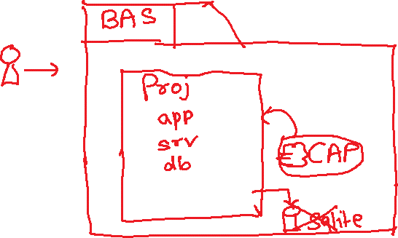




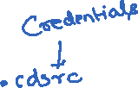





Slide 6

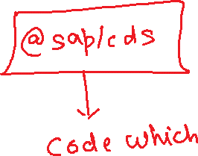




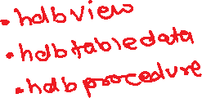
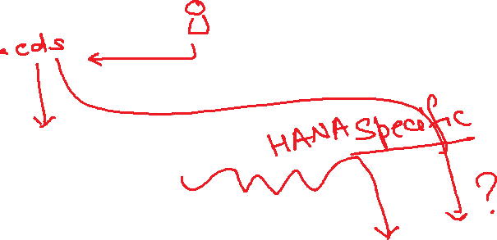


Slide 7
What is HDI – HANA Deployment Infrastructure
Applications
NodeJS
@sap/hdi-deploy
Tables, views, procedures, functions, sequences, cubes, triggers, …..
Service layer HDI
HANA > 50,000 USD
HDI Container
HDI Container
HDI Container
HDI Container
HDI Container
HDI Container
HDI Container
HDI Container
HDI Container
HDI Container
HDI Container
HDI Container

Slide 8
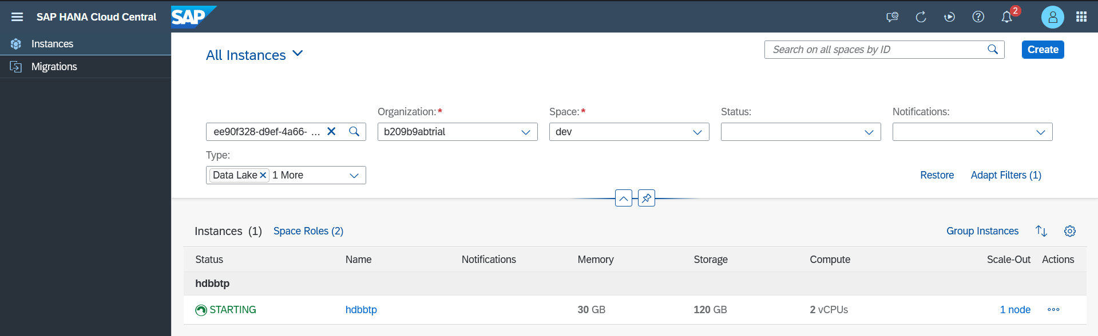
Setup SAP HANA Cloud DB free tier in BTP
www.anubhavtrainings.com

Slide 9
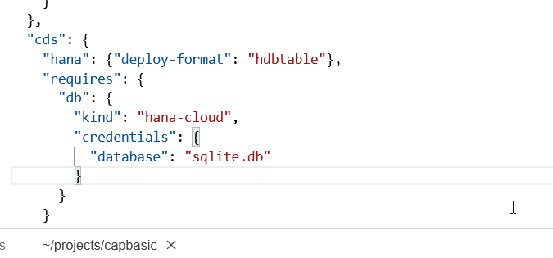
Connect, Build and Deploy to SAP HANA Cloud
Checked the version of CDS (which must be > 2.0) cds –v
Started a HANA Cloud instance in SAP BTP
We added SAP HANA configuration so our app can talk to HANA cds add hana
Added hana deployment config to tell CAPM that our format for deployment is hdbtable under cds section
"hana": {
"deploy-format": "hdbtable"
},
5. We add hana db module npm add hdb
6. Build hana specific artefacts cds build –production
7. Must login to CF cf login
8. Finally we deploy to HANA to create physical DB Object cds deploy --to hana:mickey
9. Create a new mta.yaml instead of manifest.yml, cds add mta
10. We manually added our UI Module with require as srv-api
11. Inside the app folder we added package.json with @sap/approuter module
12. Added start script for package.json with approuter.js
13. Added xs-app.json file for the routes
14. Open terminal, go to project dir, command mbt build
15. Created a new folder mta_archieve and inside that a .mtar file was create
16. We can go to CF->dev space and can see the CF microservice
www.anubhavtrainings.com

Slide 10
Cloud MTA Build Tool
Introduction
The Cloud MTA Build Tool is a standalone command-line tool that builds a deployment-ready multitarget application (MTA) archive .mtar file from the artifacts of an MTA project according to the project’s MTA development descriptor (mta.yaml file), or from the module build artifacts according to the MTA deployment descriptor (mtad.yaml file).
The archive builder is used on a file system that is independent from the development environment where the application project was created.
The archive builder is supported on Windows and Linux operating systems.
https://sap.github.io/cloud-mta-build-tool/
www.anubhavtrainings.com

Slide 11
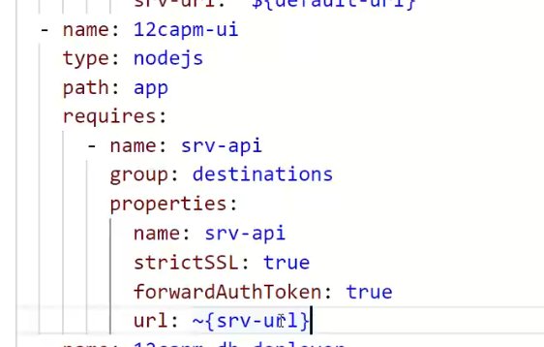
Add UI Module manually
- name: capbasic-ui
type: nodejs
path: app
parameters:
buildpack: nodejs_buildpack
requires:
- name: srv-api
group: destination
properties:
name: srv-api
strictSSL: true
forwardAuthToken: true
url: '~{srv-url}'
www.anubhavtrainings.com

Slide 12
App Router
It is a node js Application
It is used to automate our process of authorization and XSUAA token management
Redirects the access of our Microservice to XSUAA, XSUAA redirects it to IDP
IDP sends the login screen to the user, user authenticates and XSUAA release a JWT Token
App Routes takes this JWT Token, validates it and fowardAuthToken to the microservice
It serves as a single entry point for our application which perhaps has multiple microservices inside.
This configuration of each microservice to which we need to re-direct is managed using a configuration file which app router will use called xs-app.json
URL
App Router
(Reverse Proxy, Single Entry point, Façade)
xs-app.json
Java
/anubhav.svc
Node
/vendors
Fiori UI5
/index.html
www.anubhavtrainings.com

Slide 13
Banking example from Real world
Locker
Gold Loan
Home Loan
Core banking
Cheque Service
RD and FDs
www.anubhavtrainings.com

Slide 14
xs-app.json App Router Configuration
{
"welcomeFile": "purchaseorderapp/webapp/",
"authenticationMethod": "none",
"sessionTimeout": 10,
"pluginMetadataEndpoint": "/metadata",
"routes": [
{
"source": "^/purchaseorderapp/webapp/(.*)",
"target": "$1",
"localDir": "purchaseorderapp/webapp/"
},
{
"source": "^/(.*)$",
"destination": "srv-api"
}
]
}
www.anubhavtrainings.com

Slide 15
Title
www.anubhavtrainings.com

Slide 16
Title
www.anubhavtrainings.com

Slide 17

Summarize
LET’S SUMMARISE!

Slide 18

Summarize
End of Day 15

Slide 20


We’re committed to empower you to be
#FutureReady
through powerful training solutions.
We build the workforce of the future.
250+
Corporate Clients
30,000+
Learners Trained
25000+
Learners Placed
FREE WEBINARS
Sign up for free webinars with industry experts every fortnight!
Enroll Now!
Contact us today!
https://anubhavtrainings.com

